Slide 1
Introductions to Models Linear Regression & Logistic Regression
Date: August 5, 2024

Slide 2
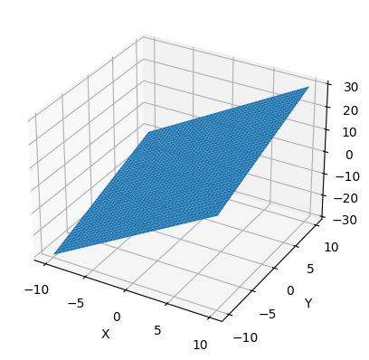
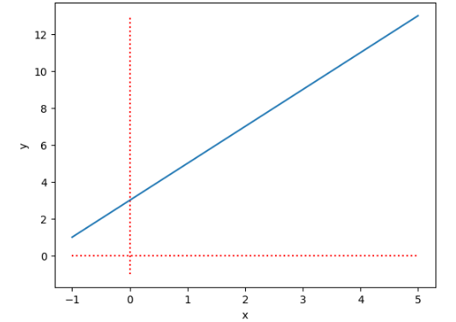
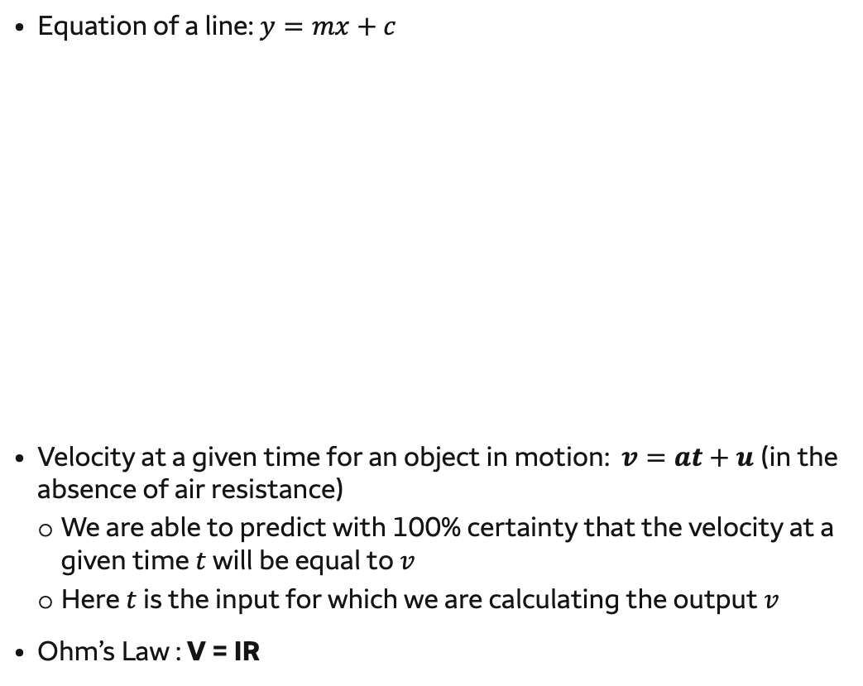


Certain Scenarios
Equation of a plane: $z=my+nx+c$
Equation of a line: $y=mx+c$
Velocity at a given time for an object in motion: $v=at+u$ (in the absence of air resistance)
We are able to predict with 100% certainty that the velocity at a given time $t$ will be equal to $v$
Here $t$ is the input for which we are calculating the output $v$
Ohm’s Law : V = IR
$$m$$
$$c$$

Slide 3
Uncertain Scenarios
However, there are a lot of phenomena for which we do not have certainty in the output we are trying to predict:
Will I get admitted to my dream school if I get a 1500 on SAT?
Relationship between admission and SAT scores
How can we predict whether a customer will default on their loan?
How much ice cream sales can one make in the summertime?
Relationship between ice cream sales and temperature
How does the weight of a car affect its fuel efficiency?
Relationship between car weight and fuel efficiency (miles/gallon)
How does practice time affect athletic performance?
Relationship between practice time and number of points scored
In these phenomena, we witness randomness. To deal with such phenomena, we build models.
Key terms:
Dependent Variable: the output that we are trying to capture. This depends on various factors.
Independent Variable: The factors on which the output depends; given these factors, we want to predict the output
Signal and noise: Given the random nature of the dependent variable, we expect some noise to be part of the output which obscures the signal
Error: The model hopes to capture the signal from the output, the difference between output and the predicted output is the error

Slide 4
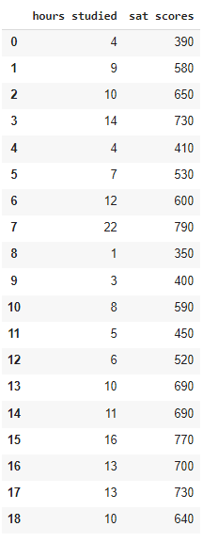
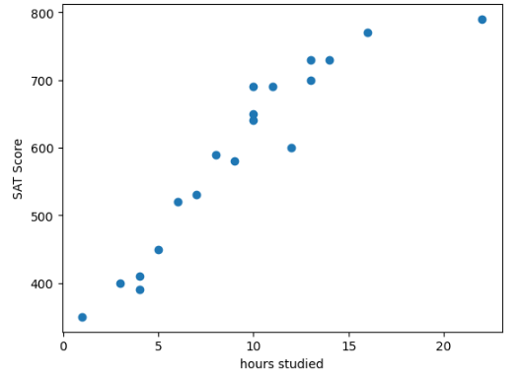
Motivation
Suppose I want to know how much I will score in SAT if I study 15 hours…
I looked at a sample of 19 students and observed how much they studied and their SAT score (table on the right)
I decide to find a pattern after plotting SAT score against hours studied. What do you think is the correct pattern and why?
A curve connecting each observation?
A straight line that seems to pass through the observations?
A line that separates observations in the middle

Slide 5
Motivation Contd.
I decide to find a pattern after plotting SAT score against hours studied. What do you think is the correct pattern and why?
A curve connecting each observation?
Likely to be misleading as the model over-fits to the noise – a new student could have a very different score
A straight line that seems to pass through the observations?
Could be a good model if it tries to minimize the squared distance between observations and the line
A line that separates observations in the middle
Bad model since the errors are large in the extremes

Slide 6
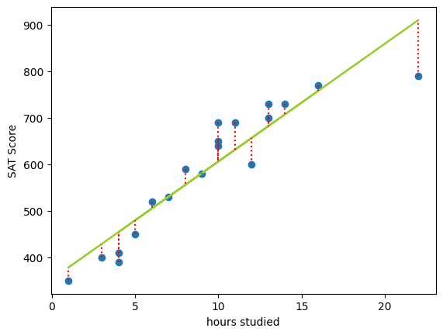
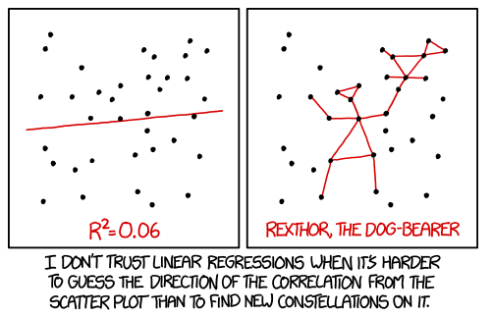

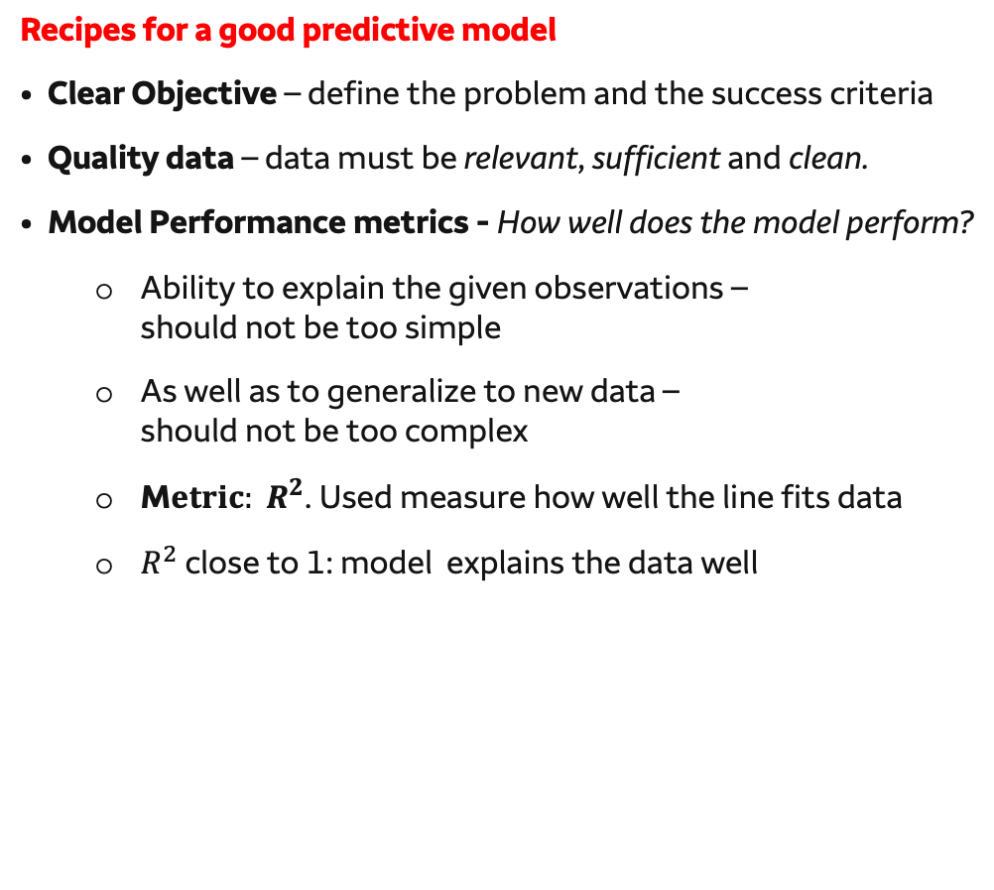
Simple Linear Regression
Given the data the most likely model is given by the green line
It tries to minimize the squared distance between the observations and the proposed line (shown in red) giving the equation for the line and expected SAT Score:
$$Predicted/Expected SAT Score=353+25.23×Hours Studied$$
Our approach is called Least Squares approach
Given this model we expect to score 732 with 15 hrs of study.
The true behavior involves some noise or error:
$$SAT Score=353+25.23×Hours Studied+ε$$
Recipes for a good predictive model
Clear Objective – define the problem and the success criteria
Quality data – data must be relevant, sufficient and clean.
Model Performance metrics - How well does the model perform?
Ability to explain the given observations – should not be too simple
As well as to generalize to new data – should not be too complex
M$etric: R^{2}$. Used measure how well the line fits data
$R^{2}$ close to 1: model explains the data well
Dependent Variable
Intercept
Slope
Independent Variable
error
Notes:
http://www.shodor.org/interactivate/activities/Regression/

Slide 7
Models in order of complexity
Linear regression
Multilayer neural networks
Logistic regression
Single-layer neural networks
Convolutional neural networks

Slide 8
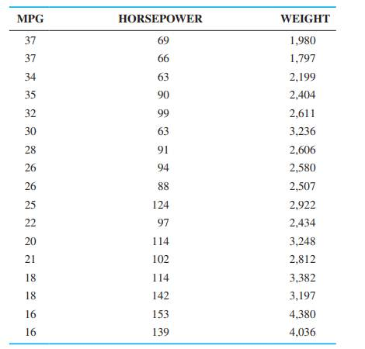
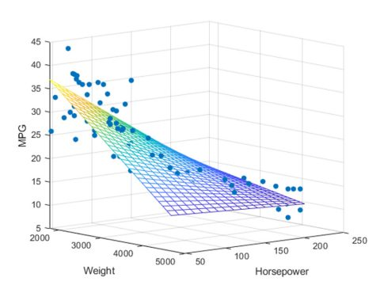

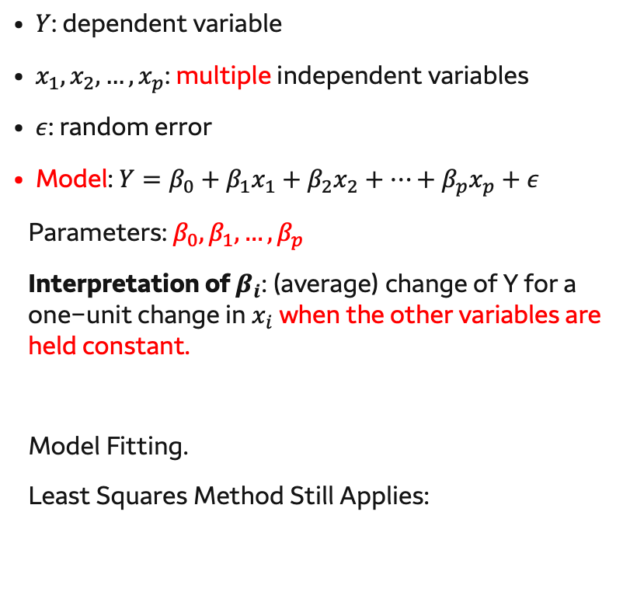

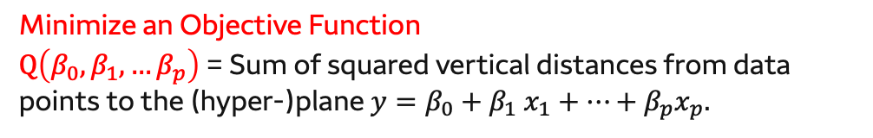
Multiple Linear Regression Model
Y
$$x_{1}$$
$$x_{2}$$
$Y$: dependent variable
$x_{1},x_{2},…, x_{p}$: multiple independent variables
$ε$: random error
Model: $Y=β_{0}+β_{1}x_{1}+β_{2}x_{2}+…+β_{p}x_{p}+ε$
Parameters: $β_{0}, β_{1},…,β_{p}$
Interpretation of $β_{i}\text{: (}\text{average}\text{) }\text{change} \text{of} \text{Y} \text{for} \text{a} \text{one}\text{−}\text{unit} \text{change} \text{in}$ $x_{i}$ when the other variables are held constant.
Model Fitting.
Least Squares Method Still Applies:
Example:
Using Horsepower
and Weight to explain
MPG
Model: $Y=β_{0}+β_{1}x_{1}+β_{2}x_{2}+e$
Data points and fitted plane
Minimize an Objective Function
$Q\left(β_{0},β_{1},…β_{p}\right)$ = Sum of squared vertical distances from data points to the (hyper-)plane $y=β_{0}+β_{1} x_{1}+…+β_{p}x_{p}.$

Slide 9
Recap
Recap simple and multiple linear regression and introduce logistic regression
Stop video at 4:34

Slide 10
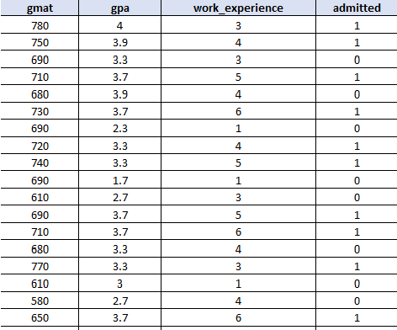
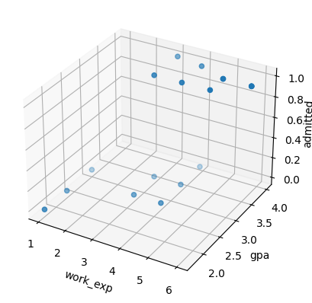
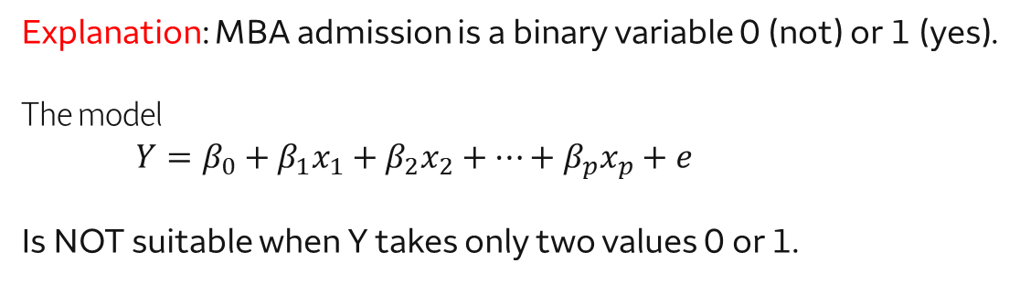
Logistic Regression: Motivation
Consider two goals:
A: Predict GMAT score using GPA and work experience.
B: Predict MBA admission using GPA and work experience.
Q: Can you use linear regression for A?
Q: Can you use linear regression for B?
Probably OK.
Definitely NOT.
Explanation: MBA admission is a binary variable 0 (not) or 1 (yes).
The model
$$Y=β_{0}+β_{1}x_{1}+β_{2}x_{2}+…+β_{p}x_{p}+e$$
Is NOT suitable when Y takes only two values 0 or 1.
Idea: How about we predict the probability of getting admitted for MBA? Probability lies between 0 and 1

Slide 11
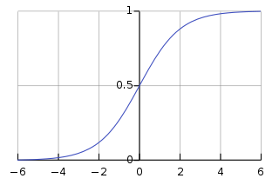
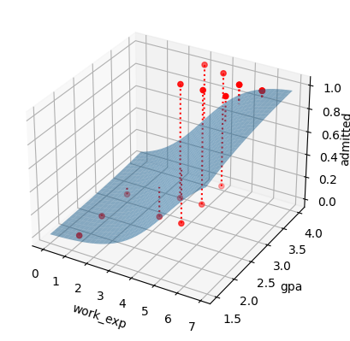
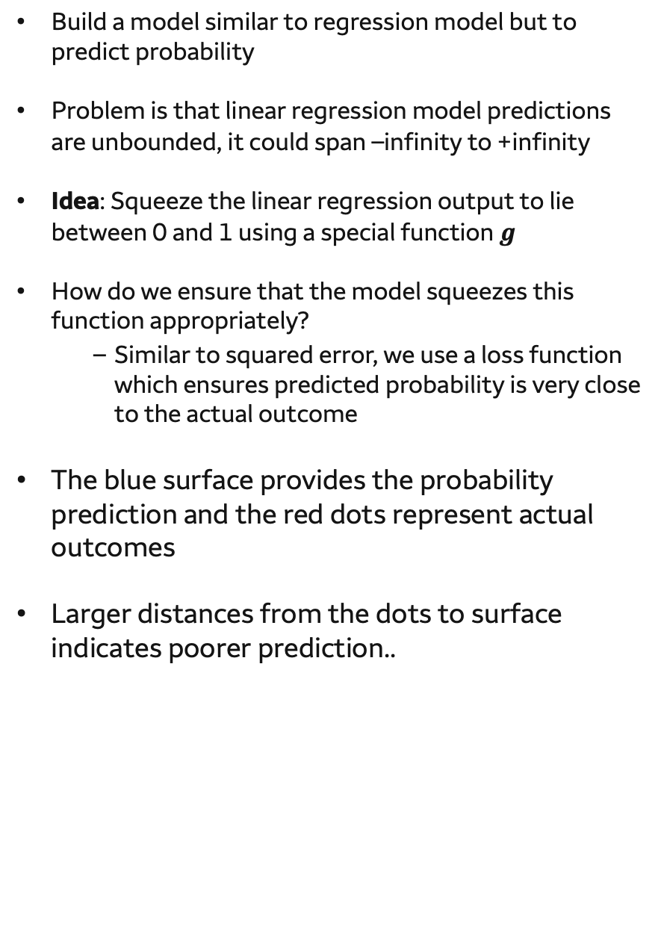
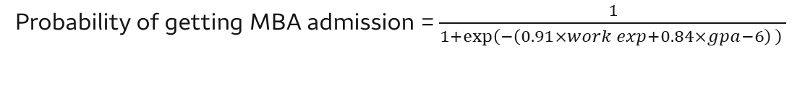
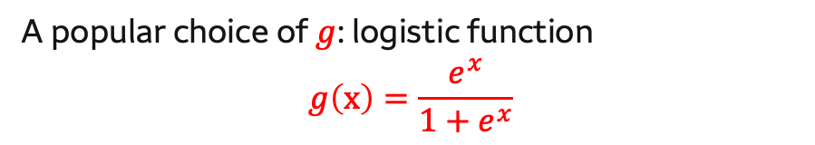
Logistic Regression: idea
Build a model similar to regression model but to predict probability
Problem is that linear regression model predictions are unbounded, it could span –infinity to +infinity
Idea: Squeeze the linear regression output to lie between 0 and 1 using a special function $g$
How do we ensure that the model squeezes this function appropriately?
Similar to squared error, we use a loss function which ensures predicted probability is very close to the actual outcome
The blue surface provides the probability prediction and the red dots represent actual outcomes
Larger distances from the dots to surface indicates poorer prediction..
A popular choice of $g$: logistic function
$$g\left(x\right)=\frac{e^{x}}{1+e^{x}}$$
Probability of getting MBA admission = $\frac{1}{1+\exp\left(−\left(0.91×work exp+0.84×gpa−6\right) \right) }$

Slide 12
Contents
Part 1: Linear Models
Part 2: Neural Networks
Introduction to linear regression
Prediction and estimation
Regression analysis
Logistic regression
Introduction to neural networks
Neural networks, today and in the past
Biological and artificial neural networks
How networks are trained
Let’s build our own networks!
Convolutional neural networks for visual recognition
Linear regression
Multilayer neural networks
Logistic regression
Single-layer neural networks
Convolutional neural networks

